Slide 1
Modern American Novel
Third Lecture
Mrs. Nouf Al-kHATTABI

Slide 2
Realism
  By 1875, American writers were moving towards realism in literature.
  American realism was a turn of the century idea in art, music and literature that showed through these different types of work, reflections of the time period.
  They were influenced by French writers who changed the relationship between society and literature. For them realism was an ideology and the novel had the power to become a political power.

Slide 3
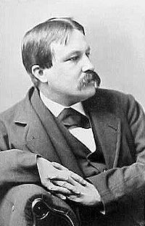
William Dean Howells
Born | March 1, 1837(1837-03-01) Martinsville, Ohio
Died | May 11, 1920 (aged 83)
Pen name | W.D. Howells
Occupation | novelist, short story writer
Nationality | American
Period | 1858-1916
Genres | Civil War writings, class issues
Literary movement | Realism

Slide 4
William Dean Howells (1837-1920)
  He was the first American realist who had many followers. Under him Realism became the mainstream of American Literature.
  As the editor of Harper’s Monthly, he made it a weapon against romanticism which created false views about life. He believed romantic novels make one forget life and duties. According to him novels should make one wish to be a more helpful and productive creature.
  He believed a good realist should present common people. However, unlike French realist, he believed an author should not make society uglier than it already is. American novels should depict the more smiling aspect of life not only crime and violence.
Notes:
More

Slide 5
William Dean Howells (1837-1920)
  Artist and art should serve poor people. So, Howells attacked the capitalism of America and argued for the unity of all people in society.
  He began to write “Utopian” novels about an ideal society with perfect justice and happiness.
  Howells’ novel A Modern Instance (1882) shocked the public since it was about divorce; a subject that is not discussed openly.
  In A Hazard of New Fortune, he turns a way from the smiling aspect of life and presents a man who learns about the sufferings of poor people in society.

Slide 6
Naturalism
  In 1890s many realist writers became naturalists. Naturalism was created by the French novelist Emile Zola.
  Naturalists use knowledge and discoveries to study the human life. They believe people are not free, but their lives and beliefs are controlled by social, economic and psychological causes.
  Naturalistic writers believed that the laws behind the forces that govern human lives might be studied and understood. Naturalistic writers thus used a version of the scientific method to write their novels; they studied human beings governed by their instincts and passions as well as the ways in which the characters' lives were governed by forces of heredity and environment.

Slide 7
Characteristics of Naturalism
The characters are usually ill-educated or lower-class characters whose lives are governed by the forces of heredity, instinct, and passion.
The setting is frequently an urban setting.
Some techniques are:
Pessimism: often, one or more characters will continue to repeat one line or phrase that tends to have a pessimistic connotation, sometimes emphasizing the inevitability of death.

Slide 8
Another characteristic of literary naturalism is detachment from the story. The author often tries to maintain a tone that will be experienced as 'objective.' Also, an author will sometimes achieve detachment by creating nameless characters. This puts the focus on the plot and what happens to the character, rather than the characters themselves.
Another characteristic of naturalism is determinism. Determinism is basically the opposite of the notion of free will. For determinism, the idea that individual characters have a direct influence on the course of their lives is supplanted by a focus on nature or fate. Often, a naturalist author will lead the reader to believe a character's fate has been pre-determined, usually by environmental factors, and that he/she can do nothing about it.
Another common characteristic is a surprising twist at the end of the story.

Slide 9
Naturalism Themes
1. Survival, determinism, violence, and taboo are key themes.
2. The strong emotions such as lust, greed, or the desire for dominance or pleasure; and the fight for survival are also some naturalistic themes .
3. Nature as an indifferent force acting on the lives of human beings.
4. The forces of heredity and environment as they affect--and afflict--individual lives.
5. An indifferent, deterministic universe. Naturalistic texts often describe the human attempts to exercise free will, in a universe where free will as an illusion.

Slide 10
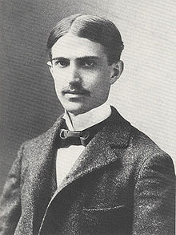
Stephen Crane

Slide 11
Stephen Crane (1871-1900)
  Crane was the first American naturalist who was not much influenced by scientific approaches.
  His characters are controlled by their environments which makes him a naturalist.
  His description of places are both realistic and poetic. He uses colors and word-sounds to create brilliant impressions. Hence, he is also a poet. His collection of poems is called War Is Kind

Slide 12
Crane’s Most Famous Works
  Maggie: A Girl of the Streets (1893), is a story of a poor girl who is betrayed by her family and becomes a prostitute. Although she wants to be good life hardships make her seem bad.
  The Red Badge of Courage (1895), is his greatest novel where the accidents of the Civil war make a young man seem as a hero. Thinking he is going to be killed, the hero runs like an animal to save his life. Then, he is accidently hit on the head and the other solders think it is a battle wound. They call it his ‘red badge of courage.’

Slide 13
At the Turn of the Century
  By the mid- 1880s, the happy well educated world of the Boston Brahmins was gone. Rich businessmen replaced the ‘aristocrats of literature’ as the leaders of Boston life.
  At the turn of the century writers were influenced by Zola’s ‘scientific’ study of man, by Darwin’s theory of evolution and by the ideas of the German philosopher Friedrich Nietzsche, which attacked Christianity.
  Usually traditional values are based on the individuals responsibility; the individual can choose between good and evil. However, the writers of this century were asking if the individual can really make such a choice because of the many outside forces that influence a person.

Slide 14
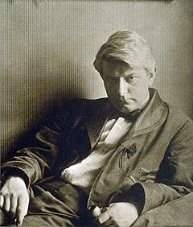
Frank Norris
Born | March 5, 1870(1870-03-05) Chicago, Illinois, United States
Died | October 25, 1902 (aged 32) San Francisco, California
Pen name | Frank Norris
Occupation | Novelist, Writer
Nationality | American

Slide 15
Frank Norris (1870-1902)
  The characters actions in Norris’ works reflect the ideas of this century. They are often unable to control their lives, for they are controlled by ‘passion’ and ‘fate.’
  Norris’ style is different from other naturalists because his techniques of description are closer to romantic writers.
  In Mcteague (1899), describes the life of a turn-of-the-century dentist in San Francisco, named McTeague. The narrator never reveals McTeague's first name; he is referred to only as "Mac" by the other characters in the novel.
  The Octopus (1901), describes the raising of wheat in California, and the conflict between the farmers and the railway company. The book emphasized the control of "forces" such as wheat and railroads over individuals.

Slide 16
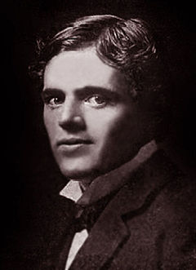
Jack London in 1900
Born | January 12, 1876(1876-01-12) San Francisco, California United States
Died | November 22, 1916 (aged 40) Glen Ellen, California United States
Occupation | Novelist, journalist, short story writer and essayist
Literary movement | Realism and Naturalism

Slide 17
Jack London (1876-1916)
  Although London died at the age of forty, he had an amazing career. He was a self-educated man. Sometimes he was a Darwininan naturalist, other times he was a Marxian socialist. Later, he rejected socialism and supported a kind of white racism. Although he often changed his philosophy, the quality of his writing was always high.
  Like Norris, London was deeply influenced by Darwins ideas of constant struggle in nature and the survival of the strongest. Hence, the heroes of some of his works are animals. Also, the laws of nature govern everything and everyone inside and outside society and sometimes the people are defeated by these laws.

Slide 18
Jack London’s works
  The Call of the Wild (1903), is London's most-read book, and it is generally considered his best, the masterpiece of his so-called "early period". Because the protagonist is a dog, it is sometimes classified as suitable for children, but it is dark in tone and contains numerous scenes of cruelty and violence. Buck, the dog, is taken from his easy life in California to freezing Alaska. He survives because he is superior.
  Some of his other works are: The Sea-Wolf (1904),and To Build a Fire (1910)

Slide 19
Muckraker Era
  The big businessmen and big capitalists were becoming the bad guys in the American society. The American public began to feel that ‘dirty politics’ and ‘dirty business’ had gone too far in American society. At the turn of the century even the president expressed this idea. President Roosevelt announced that a war must be lead against the political, social and economic evils. In politics, this was the ‘progressive era.’ In newspapers and literature from 1900 to 1914 it was ‘Muckraker Era.
  The job of the Muckrakers was to print the truth, however unpleasant it is in their magazines and later in their books.

Slide 20
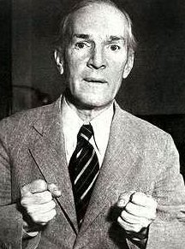
Upton Sinclair
Born | September 20, 1878(1878-09-20) Baltimore, Maryland
Died | November 25, 1968 (aged 90) Bound Brook, New Jersey
Occupation | Novelist, writer, journalist, political activist
Nationality | American

Slide 21
Upton Sinclair (1878-1968)
  The most famous of Muckraker, Sinclair, believed in human goodness and was sure society could change. For him Muckraker was “almost a religious mission.”
  Almost in all his novels, his characters seem flat and lifeless. However, his main interest was the message not the characters. His novels tried to force the society to change, because his works succeeded in correcting many of the evils they described.
  The Jungle (1906), is written to highlight the plight of the working class and to remove from obscurity the corruption of the American meatpacking industry during the early-20th century. The novel depicts in harsh tones the poverty, absence of social programs, unpleasant living and working conditions among the working class, which is contrasted with the deeply corrupted world of those in power. The sad state of turn-of-the-century labor is placed front and center for the American public to see, suggesting that something needs to be done.

Slide 22
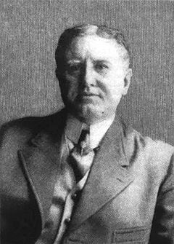
William Sydney Porter
Born | William Sidney Porter September 11, 1862(1862-09-11) Greensboro, North Carolina, United States
Died | June 5, 1910 (aged 47) New York City, New York, United States
Pen name | O. Henry, Olivier Henry
Occupation | Writer

Slide 23
O. Henry (1862-1910)
  Henry usually used his own experiences as ideas for stories. Like Twain, he wrote in an easy journalistic style. His stories begin with an action and move quickly to its conclusion. They are filled with deep portraits of the lives of ordinary people and he always takes the side of the weak against the strong.
  His plots are written according to formulas. One Formula is the ‘reversal’ as an action by a character produces the opposite effect from the one he had been hoping for. For example, when a little boy is kidnapped, he reverses the action and makes the men his prisoners. Another Formula is to keep an important piece of information from the reader until the end.
  His first collection of short stories is Cabbages and Kings (1904).

Slide 24
THANK YOU

